Slide 1

Smart University Parking (SUP)
A project by:
Sathyanand Kodi
David Zou
Abhay Dogra
Raaga Tanu
Jess Rumao

Slide 2

Agenda
EXECUTIVE SUMMARY
OBJECTIVES
ASSUMPTIONS
SCOPE
DELIVERABLES
ACCEPTANCE CRITERIA
STAKE HOLDERS

Slide 3


EXECUTIVE SUMMARY
The goal of this project is to address the limited information available to users regarding the availability of on-campus parking spaces.
The project name is Smart University Parking System.
In response to the growing need for efficient campus parking management, our System Analysis Project presents a comprehensive solution – A real-time parking availability map.
This System aims to streamline the parking experience for staff, students, and visitors by providing up-to-the-minute information on the available parking slots across the campus.
The SUP system will allow Data-Driven Decision Making for users with the benefits of
1. Providing valuable parking information in a real-time for users to make smart decisions.
2. Improving user experience by reducing frustration from search time and road congestion.

Slide 4
OBJECTIVES
Integrate with existing parking system
Develop a user-friendly real time map
Capture real time parking spot availability using IOT sensors
Reduce user search time

Slide 5

ASSUMPTIONS
Applicable for only UTD for this phase​.
Access to university's wifi/network for IOT sensors connectivity.
Availability of suitable power sources for IOT sensors.

Slide 6
SCOPE
Deployment of IoT sensors in all university parking areas.
Development of a real-time map for users to access parking lot information.
Integration with the university's existing infrastructure.
Reduce user search time and parking congestion

Slide 7
DELIVERABLES
• Deployment of IoT sensors and connectivity.
• Real-time map for parking management.
• Integration of real-time map with university servers and databases.
• User training and documentation.

Slide 8
ACCEPTANCE CRITERIA
• IoT sensors accurately detect space availability in parking lots or garages.
• The real time map is user friendly , bug free and functional.
• Parking congestion within the university is reduced significantly.
•.

Slide 9
STAKE HOLDERS
University Administration
Students
Faculty and Staff
Visitors
UTD IT Department
UTD Auxiliary Service Department
Project Team

Slide 10

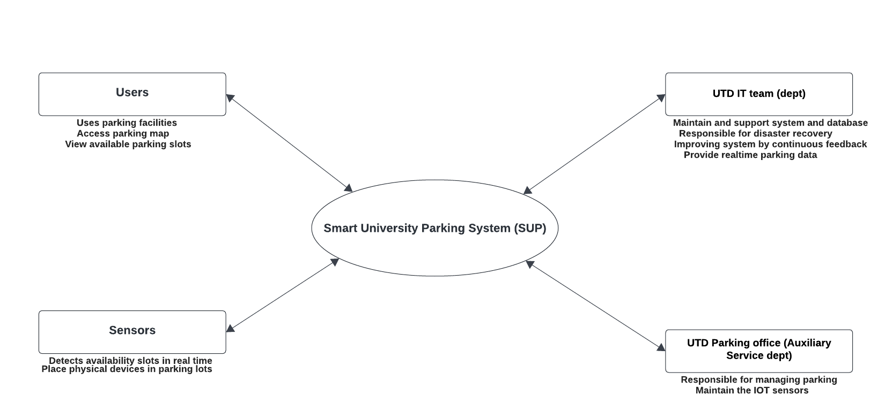



CONTEXT DIAGRAM

Slide 11
USE CASE DESCRIPTION
Use Case Name: View map/Open website on device
Scenario: User wants to view the map to know the number of parking spots available.
Triggering Activity: User needs information on parking availability
Brief Description: User views the map/opens the web application on their electronic device
Actors: User
Related use cases: Display parking data in SUP System Map
Stakeholders: UTD Auxiliary Service Department, UTD ID Department, User (Includes Students, Faculty and Staff, and Visitors)
Preconditions: User’s device and internet connection is in working order. UTD system and network is operational.
Postconditions: User is informed of number of parking spots available. Map is accurate and free of bugs.
Flow of Activities: User intends on checking the number of spots available for them to park in a specific parking structure on campus User opens the website on their electronic device (phone, tablet, laptop) User views the map and sees how many spots are available in the parking structure of their choosing User decides to which parking structure to park in depending on the availability
Exception Conditions: UTD system outage Data is unavailable or inaccurate User’s device is incompatible and they are unable to view the map

Slide 12
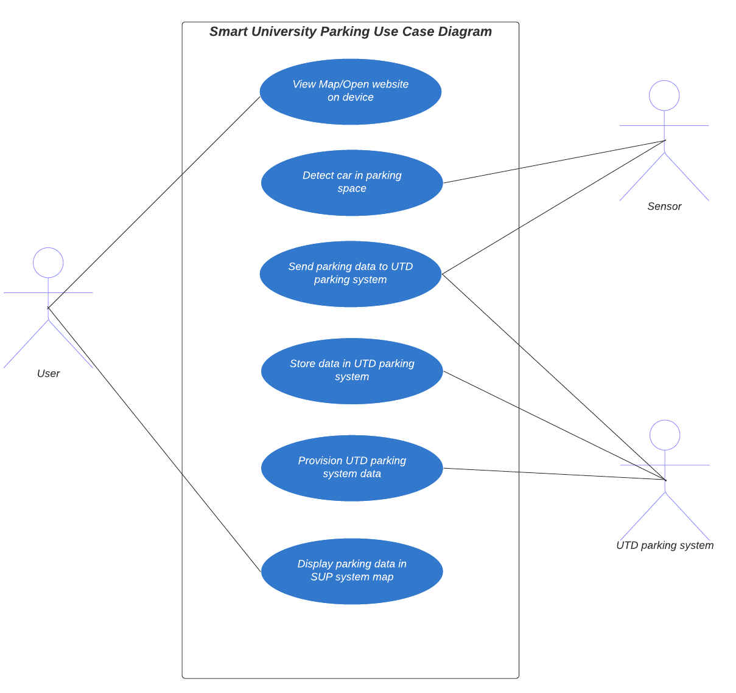
USE CASE DIAGRAM

Slide 13
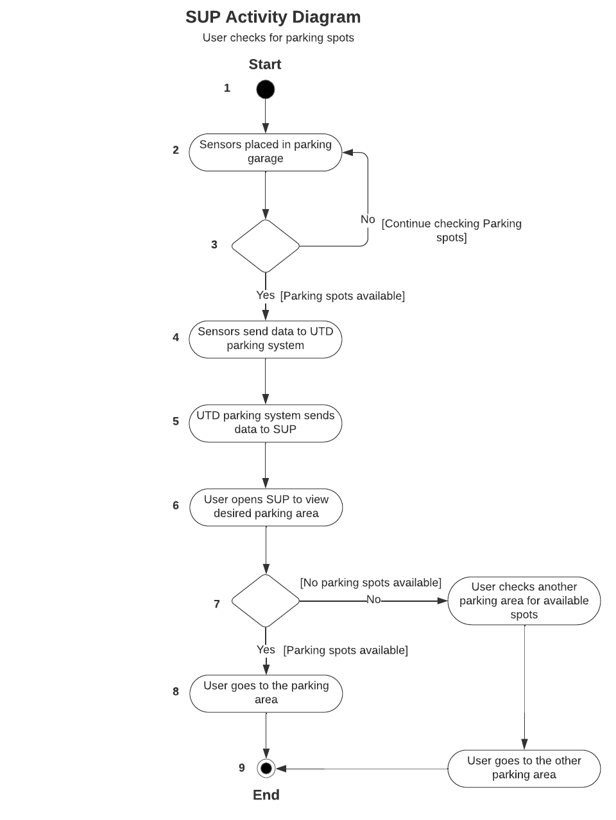
ACTIVITY FLOW DIAGRAM

Slide 14
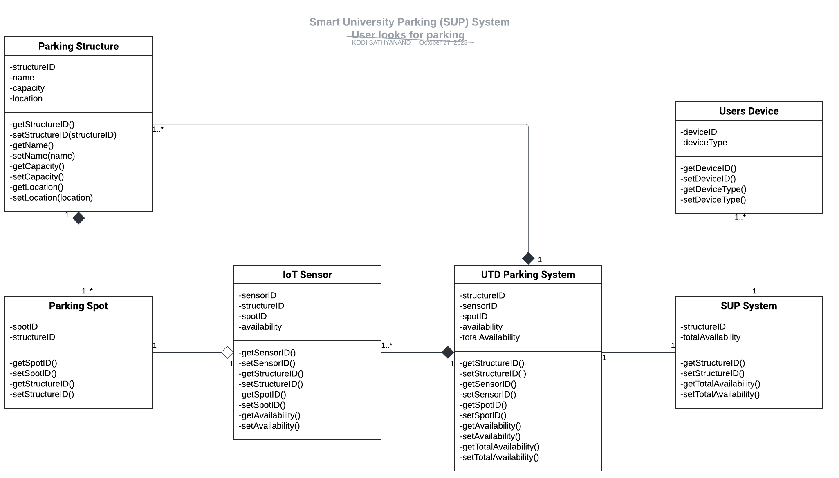
CLASS DIAGRAM

Slide 15
DATA DICTIONARY NOTATION
Parking Structure = structureID + name + capacity + location:
Parking Spot = spotID + structureID
IoT Sensor = sensorID + structureID + spotID + availability
availability = [Yes|No]
UTD Parking System = structureID + sensorID + spotID + availability + totalAvailability
SUP System = structureID + totalAvailability
Users Device = deviceID + (deviceType)
Type: String
Length: 05
Picture: 123456 546789
Source: Brand Class
Update: No
Data element name: structureID,
Aliases: Structure ID
Definition: Unique ID number for parking structure identification

Slide 16
WORK BREAKDOWN STRUCTURE
Planning tasks​
Develop Proposal - 2 Days​
Develop Context Diagram - 2 Days​
Develop WBS - 2 Days​
Develop UC Desc and Diagrams - 3 Days​
Develop Process Models - 3 Days​
Analysis tasks​
Meet with UTD IT department - 2 Days​
Meet with UTD Auxiliary Service department - 2 Days​
Meet with UTD Visitors department - 2 Days​
Define required parking data elements - 3 Days​
Define disaster recovery plan - 3 Days​
Design tasks​
Design real-time map layout and screen - 3 Days​
Design data integration into map - 3 Days​
Design integration with UTD Auxiliary Services - 4 Days​
Build tasks​
Integrate database with UTD IT team - 4 Days​
Timely documentation for development - 3 Days​
Develop code for real-time map web page - 7 Days​
Integrate database data into the map - 4 Days​
Create test data and test cases - 3 Days​
Conduct initial functional testing - 3 Days​
Conduct acceptance testing with users - 3 Days​
Conduct load and performance testing - 3 Days​
Prepare for go-live release - 2 Days​
Deployment tasks​
Release live version for use - 1 Day​
War-room to troubleshoot any tickets or bugs - 7 Days​
Hand-off to UTD IT team - 3 Days​
Project closure and retrospective - 2

Slide 17
DISASTER RECOVERY PLAN FOR SMART UNIVERISTY PARKING SYSTEM
Establish guidelines for the rapid recovery of the Smart University Parking System (SUP) in case of a disaster.​
Scope​
Covers the recovery of critical SUP components: IoT sensors, real-time map, and integration with university servers.​
Objectives​
Minimize downtime and restore functionality promptly.​
Ensure continuity of parking management services.​
Clearly define roles and responsibilities.​

Slide 18
RISK ASSESSMENT
Potential Risks​
Natural Disasters​
Cybersecurity Threats​
Physical Damage to infrastructure​
Cloud provider outage (AWS)​
Impact Analysis​
Downtime​
Data Loss​
Reputation Damage​
RTO and RPO​
RTO: Maximum time to restore normal operations.​
RPO: Maximum tolerable data loss.​

Slide 19
DISASTER RECOVERY PROCEDURES
Emergency Response​
Activation: Emergency response team led by Project Team.​
Assessment: Assess nature and extent of the disaster.​
Communication: Establish communication with stakeholders.​
Recovery Steps​
Infrastructure Recovery​
Assessment: Evaluate physical damage.​
ess to users and stakeholders.​
Inventory Management: Assess working IoT sensors for replacements.​
Restoration: Repair or replace damaged components.​
Data Center Restoration: Restore and verify server and database integrity.​
System Functionality​
IoT Sensor Validation: Validate sensor functionality.​
Real-time Map: Ensure accessibility to the UTD parking map.​
Integration: Re-establish integration with university servers.​ ​
User Communication​
User Instructions: Provide instructions during recovery phase.​
Status Updates: Communicate recovery progr

Slide 20
TESTING TRAINING AND DOCUMENTATION
Testing​
Regular Drills: Conduct periodic recovery drills.​
Scenario-Based Testing: Simulate disaster scenarios for resilience evaluation.​
Training​
Team Training: Ensure emergency response team is trained.​
User Awareness: Educate users on alternative methods during downtime.​
Documentation​
Review and Update: Regularly review and update the DRP.​
Distribution: Ensure stakeholders have access to the latest version.​
Documentation: Provide clear instructions during downtime.​
Training Sessions: Conduct sessions for users on alternative methods.​

Slide 21
CONCLUSION
This Disaster Recovery Plan aims to ensure the rapid and effective recovery of the Smart University Parking System in the face of unforeseen disasters or disruptions. Regular testing, training, and documentation updates are essential to the plan's ongoing effectiveness. The cooperation of all stakeholders is crucial for successful implementation in the event of a disaster.​

Slide 22
THANK YOU & HAPPY PARKING UT DALLAS

